Slide 1
SAP Summer School
ABAP Objects

Slide 2

Course Agenda
Object Oriented Programming in ABAP
Structure of an ABAP class
Advanced Concepts in ABAP Objects
Global Classes
Design Pattern

Slide 3
1. Object Oriented Programming in ABAP
Course Objectives:
  Learn the basic principles of the object oriented programming paradigm using ABAP Objects
  Learn the difference between procedural and object oriented programming with examples from ABAP language

Slide 4
Example of a Typical ABAP Program
1. Object Oriented Programming in ABAP
REPORT ZABAP_DEMO.
*----------------------
TYPES: ...
DATA: ...
...
PERFORM form1 ...
CALL FUNCTION 'ZFUNCTION1' ...
CALL FUNCTION 'ZFUNCTIONX' ...
...
*----------------------
FORM form1 ...
...
ENDFORM.
Data declaration is commonly separated from the actual functionality ( with ABAP 7.4 inline data declarations also possible)
Function modules and forms are used for modularization
Function modules and forms encapsulate functionality -> reusable

Slide 5
Example of a Function Group
1. Object Oriented Programming in ABAP
FUNCTION-POOL s_vehicle.
* speed is a global variable
DATA: speed TYPE I.
...
FUNCTION INC_SPEED.
...
ADD imp_speed TO speed.
ENDFUNCTION.
FUNCTION DEC_SPEED.
...
SUBTRACT imp_speed FROM speed.
ENDFUNCTION.
FUNCTION GET_SPEED.
exp_speed = speed.
ENDFUNCTION.
Example of a function group that adjusts the speed of a vehicle
The variable speed is a global variable used in the function-pool
S_VEHICLE
speed
inc_speed
dec_speed
get_speed
stop

Slide 6
More Instances of a Function Group?
1. Object Oriented Programming in ABAP
S_VEHICLE
It is possible to obtain a greater number of vehicles with different actual speed only with additional programming effort.
speed
inc_speed
dec_speed
get_speed
?
stop

Slide 7
Instantiating Objects in the Object Oriented Languages
1. Object Oriented Programming in ABAP
Objects are key concepts in the object-oriented programming. Having more instances of the same type, objects are characterized by their attributes.
Each instance (object) has its own state that is determined by the values of its attributes and can be changed via methods of the class.
speed
speed
speed
speed

Slide 8
An Overview of the OOP Features
1. Object Oriented Programming in ABAP
Methods
Encapsulation of data and functionality
Polymorphism encourages generic programming
Inheritance
Enables better structuring and maintainability in the software development process
Data
Methods
Code 2
Code 1
display_data
Code 3
Father
Code 4
Son 1
Son 2
Notes:
In classical procedural programming, the state of an application is determined by the content of the global variables of a program.
In object-oriented programming, the state is encapsulated in classes or objects as instances of classes.

Slide 9

Introduction ABAP Objects
1. Object Oriented Programming in ABAP
ABAP Objects is an extension of ABAP
ABAP OO can be used in the classical procedural programming (e.g. can access classes in classical processing blocks, call classical programs and procedures within methods)
Two types of classes:
  Local Classes:
    Usually defined in the body of a report
    Visible only inside the report
    Naming convention: lcl_<class_name>
  Global Classes
    Visible everywhere
    Can be created / altered FORM-BASED or SOURCECODE-BASED
Notes:
The procedural programming model is based on the modularization of programs in classical processing blocks, that is, event blocks, dialog modules, function modules, and subroutines

Slide 10
Introduction ABAP Objects cont.
1. Object Oriented Programming in ABAP
Each class can have several subclasses, but only one superclass(1).
Instance methods can be redefined in subclasses, but static methods cannot be redefined.
Redefining a method means creating a new implementation of the method in a subclass without changing the interface
Overloading methods is not supported
All classes in ABAP Objects that do not explicitly inherit from another class are implicitly direct subclasses of object.
Abstract classes can be used as a template for subclasses. An abstract method cannot be implemented in its own class, but instead only in its subclass.
Friendship relationship between classes can be defined.
  If class A defines itself as a friend to class B then class B will have access to all the private and protected attributes and methods of class A.
Other programming languages allow a class to be derived from several classes. This mechanism is referred to as multiple inheritance and is not implemented in ABAP Objects.
Notes:
Static methods cannot be redefined in ABAP Objects, because static components should occur exactly once (i. e., not more or less) in a path so that they can be shared by all subclasses.

Slide 11
2. Structure of an ABAP class
CLASS lcl_demo DEFINITION.
PUBLIC SECTION.
...
PROTECTED SECTION.
...
PRIVATE SECTION.
...
ENDCLASS.
CLASS lcl_demo IMPLEMENTATION.
...
ENDCLASS.
ABAP source code is enclosed within the statements CLASS - ENDCLASS
Definition of class components (attributes and signatures of methods) are separated from the actual implementation.
There are three levels of visibility:
  Public
  Protected
  Private
Notes:
Public section: These components can be accessed externally using component selectors.
Protected section: The protected visibility section of a subclass contains all protected components of all superclasses, plus its own additional protected components. These components cannot be accessed externally using component selectors. From an external point of view, “protected” is the same as “private.”
Private section: The private visibility section of a subclass contains only the subclass’s own private components. These components can only be accessed in the method implementations of the subclass.

Slide 12
Class- and Instance- attributes/methods
2. Structure of an ABAP class
CLASS lcl_demo DEFINITION.
PUBLIC SECTION.
METHODS: ...
CLASS-METHODS: ...
PROTECTED SECTION.
...
PRIVATE SECTION.
DATA: ...
CLASS-DATA: ...
ENDCLASS.
CLASS lcl_demo IMPLEMENTATION.
...
ENDCLASS.
Declare static attributes (variables or constants) of the class using the statement CLASS-DATA
Declare static methods, which can access only static attributes of the class using the statement CLASS-METHODS
Instance methods and attributes are declared using the METHODS and DATA keywords respectively
Analog: constructor and class-constructor

Slide 13
Instance and static constructors
2. Structure of an ABAP class
The instance constructor ( having the name CONSTRUCTOR) is an instance method of a class which is automatically called when the class is instantiated, after the generation of an object.
Each class has exactly one instance constructor, which has to be declared in the PUBLIC SECTION of the class definition ( after the METHODS: keyword).
An instance constructor can have IMPORTING parameters and exceptions
The static constructor( having the name CLASS-CONSTRUCTOR) is called once per class and internal session, before the class is accessed for the very first time.
Each class has exactly one static constructor, which has to be declared in the PUBLIC SECTION of the class definition ( after the CLASS-METHODS keyword).
A static constructor cannot have any parameters and cannot raise exceptions.
An instance constructor is used in order to assign some particular attribute values to a specific object, while the static constructor is used to fill some constant values which do not change during the program lifetime.

Slide 14

Method parameters
2. Structure of an ABAP class
IMPORTING
  Input parameter
  Naming convention: each importing parameter starts with I ( iv_<name>/ is_<name> / it_<name> )
EXPORTING
  Output parameter
  Naming convention: each exporting parameter starts with E ( ev_<name>/ es_<name> / et_<name> )
CHANGING
  Input/Output parameter
  Naming convention: each changing parameter starts with C ( cv_<name>/ cs_<name> / ct_<name> )
RETURNING
  Output parameter
  Passed by value
  Only one per method
  Naming convention: each returning parameter starts with R ( rv_<name> / rs_<name> / rt_<name> )

Slide 15
Local Classes: Example
2. Structure of an ABAP class
CLASS lcl_demo DEFINITION.
PUBLIC SECTION.
METHODS: constructor
IMPORTING
iv_studnr TYPE zstudentnr,
display_data.
PRIVATE SECTION.
DATA: mv_studnr TYPE zstudentnr.
ENDCLASS.
CLASS lcl_demo IMPLEMENTATION.
METHOD constructor.
me->mv_studnr = iv_studnr.
ENDMETHOD.
METHOD display_data.
DATA: ls_student TYPE zstudent.
SELECT * INTO ls_student
FROM zstudents
WHERE studentnr = me->mv_studnr.
WRITE: ls_student-fname,
ls_student-lname,
ls_student-studnr.
ENDSELECT.
ENDMETHOD.
ENDCLASS.

Slide 16
Class Instantiation
2. Structure of an ABAP class
Declaring a reference variable (of specified type)
PARAMETERS pa_studnr TYPE zstudentnr.
DATA: lr_demo TYPE REF TO lcl_demo.
START-OF-SELECTION.
CREATE OBJECT lr_demo EXPORTING iv_studnr = pa_studnr.
* lr_demo = NEW lcl_demo( iv_studnr = pa_studnr ).
lr_demo->display_data( ).
CLEAR lr_demo.
Instantiating objects with CREATE OBJECT
Passing Constructor Parameters
The local reference variable is garbage collected by using the statement CLEAR.

Slide 17
Method Calls and Attributes
2. Structure of an ABAP class
Calling an instance method / referring to an instance attribute:
  lv_name = lr_student->get_name( ).
  lv_age = lr_student->mv_age.
Calling a static method/attribute:
  lv_kg = cl_math_util=>convert_lbs_to_kg( 500 ).
  lv_color_red = cl_global_constants=>mc_color_red.
Chaining is allowed:
  lv_teacher_name = lr_student->get_teacher( )->get_name( ).

Slide 18
Functional Methods
2. Structure of an ABAP class
Definition:
  one RETURNING parameter (value)
  any number of IMPORTING parameters and exceptions
Functional method call:
  a) RECEIVING parameter
  b) direct invocation is possible in different instructions:
    MOVE, CASE, LOOP
    logical instructions (IF, ELSEIF, WHILE, CHECK, WAIT)
    arithmetic and logical instructions (COMPUTE)
    e.g. a = b + c
Example:
a = b +
Functional Method
Notes:
…
As an operand in the CASE statement, as an operand in the WHEN statement, as an operand in the WHERE condition for internal tables

Slide 19
Functional Methods: Example
2. Structure of an ABAP class
CLASS lcl_vehicle DEFINITION.
PUBLIC SECTION.
METHODS: get_average_fuel
IMPORTING iv_distance TYPE s_distance,
iv_fuel TYPE ty_fuel
RETURNING VALUE(rv_fuel) TYPE ty_fuel,
ENDCLASS.
DATA: lr_vehicle1 TYPE REF TO lcl_vehicle,
lr_vehicle2 TYPE REF TO lcl_vehicle,
avg_fuel TYPE ty_fuel.
...
* example for short syntax in aritmet. operation
avg_fuel =
r_vehicle1->get_average_fuel( iv_distance = 500 iv_fuel = 50 )
+ r_vehicle2->get_average_fuel( iv_distance = 600 iv_fuel = 60 ).

Slide 20

3. Advanced Concepts in ABAP Objects
Casting
Inheritance and Polymorphism

Slide 21
Upcast Example
3. Advanced Concepts in ABAP Objects
DATA: lr_vehicle TYPE REF TO lcl_vehicle,
lr_truck TYPE REF TO lcl_truck. “lcl_truck extends lcl_vehicle
(5) lcl_truck
CREATE OBJECT lr_truck.
Public
Inherited
get_make
get_count
lr_truck
Redefined
display_attributes
set_attributes
estimate_fuel
* upcast
lr_vehicle = lr_truck
get_cargo
...
lr_vehicle

Slide 22
Compatibility and Upcast
3. Advanced Concepts in ABAP Objects
An instance of a subclass can be used in any context, in which an instance of the superclass is used.
The components inherited from the superclass can be addressed.
DATA: lr_vehicle TYPE REF TO lcl_vehicle,
lr_truck TYPE REF TO lcl_truck,
level TYPE ty_level.
* Generic access of subclass-methods
level = lr_truck->estimate_fuel( 1000 ).
* upcast
r_vehicle = lr_truck.
* Use of subclass-instance through superclass variable
level = lr_vehicle->estimate_fuel( 1000 ).

Slide 23
Generic Access & Polymorphism
3. Advanced Concepts in ABAP Objects
1
1..*
lcl_rental
lcl_vehicles
Client
lcl_truck
lcl_bus
(1) lcl_rental
Public
Private
?
itab
(4) lcl_bus
(2) lcl_car
(5) lcl_truck

Slide 24
Generic Access & Polymorphism
3. Advanced Concepts in ABAP Objects
(1) lcl_rental
2 lcl_bus
Client
Public
Private
vehicle_list
add_vehicle
3 lcl_truck
4 lcl_car
...
METHODS: add_vehicle IMPORTING im_vehicle TYPE REF TO lcl_vehicle.
...

Slide 25
Generic Access & Polymorphism
3. Advanced Concepts in ABAP Objects
CLASS lcl_rental DEFINITION.
PUBLIC SECTION.
METHODS add_vehicle IMPORTING im_vehicle TYPE REF TO lcl_vehicle.
METHODS calc_estimated_fuel RETURNING VALUE(re_fuel) ...
PROTECTED SECTION.
DATA: vehicle_list TYPE TABLE OF REF TO lcl_vehicle.
ENDCLASS.
CLASS lcl_rental IMPLEMENTATION.
METHOD add_vehicle.
APPEND im_vehicle TO vehicle_list.
ENDMETHOD.
METHOD calc_estimated_fuel.
DATA: r_vehicle TYPE REF TO lcl_vehicle.
LOOP AT vehicle_list INTO r_vehicle.
re_fuel = re_fuel + r_vehicle->estimate_fuel( im_distance ).
ENDLOOOP.
ENDMETHOD.
ENDCLASS.

Slide 26
Generic Access & Polymorphism
3. Advanced Concepts in ABAP Objects
METHOD calc_estimated_fuel.
DATA: r_vehicle TYPE REF TO lcl_vehicle.
LOOP AT vehicle_list INTO r_vehicle.
re_fuel = re_fuel + r_vehicle->estimate_fuel( im_distance )
ENDLOOOP.
ENDMETHOD.
(5) lcl_truck
METHOD estimate_fuel. ...
total_weight = max_passengers *
average_weight + weight.
re_fuel = total_weight *
im_distance * factor.
ENDMETHOD.
Öffentlich
Geerbt / redefiniert
Estimate_fuel
(2) lcl_bus
METHOD estimate_fuel. ...
total_weight = max_cargo + weight.
re_fuel = total_weight *
im_distance * factor.
ENDMETHOD.
Öffentlich
Geerbt / redefiniert
Estimate_fuel

Slide 27
Downcast Example
3. Advanced Concepts in ABAP Objects
(2) lcl_bus
(1) lcl_rental
5 lcl_rental
vehicle_list
(3) lcl_truck
get_max_cargo
max_cargo = 30
(4) lcl_car
METHOD get_max_cargo.
DATA: r_vehicle TYPE REF TO lcl_vehicle,
r_truck TYPE REF TO lcl_truck.
LOOP AT vehicle_list INTO r_vehicle.
TRY.
r_truck ?= r_vehicle.
* put max cargo in variable re_cargo...
CATCH cx_sy_move_cast_error.
* react on that cast error
ENDTRY.
ENDLOOP.
ENDMETHOD.
(9) lcl_truck
max_cargo = 50

Slide 28
4. Global Classes
Local classes:
  Local classes are visible only within the program where they were defined
  Cannot be searched for by name
Global classes:
  Are visible across the entire system
  Are created in the ABAP Workbench using the Class Builder
  Searching for global classes in the ABAP Repository is possible

Slide 29
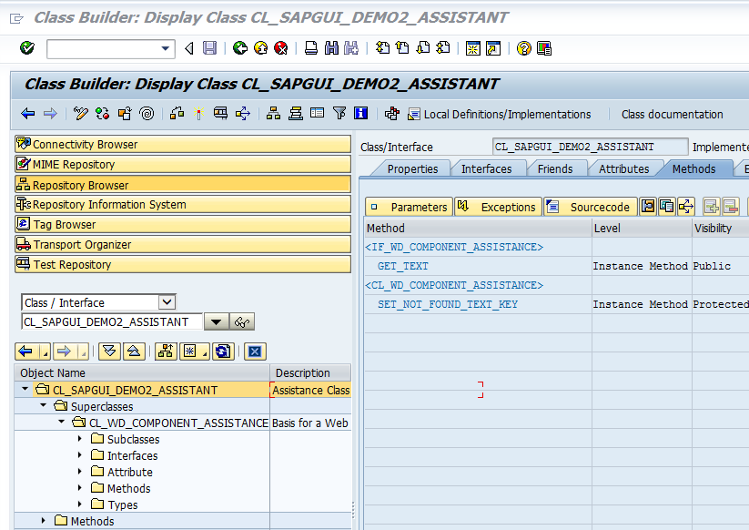
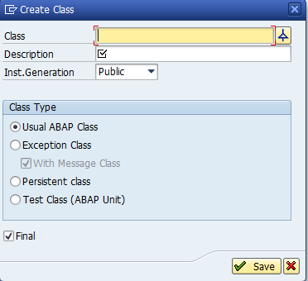
Global Classes in the Object Navigator
4. Global Classes
Create a new class within
the Object Navigator:

Slide 30
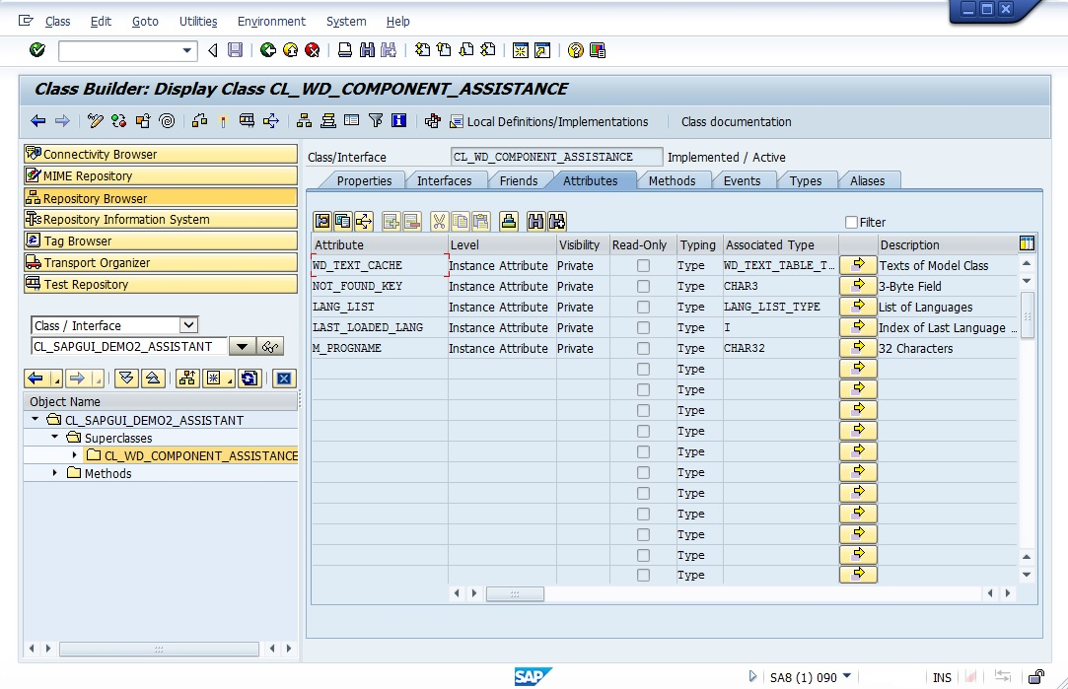
Global Classes in the Object Navigator: Attributes
4. Global Classes

Slide 31
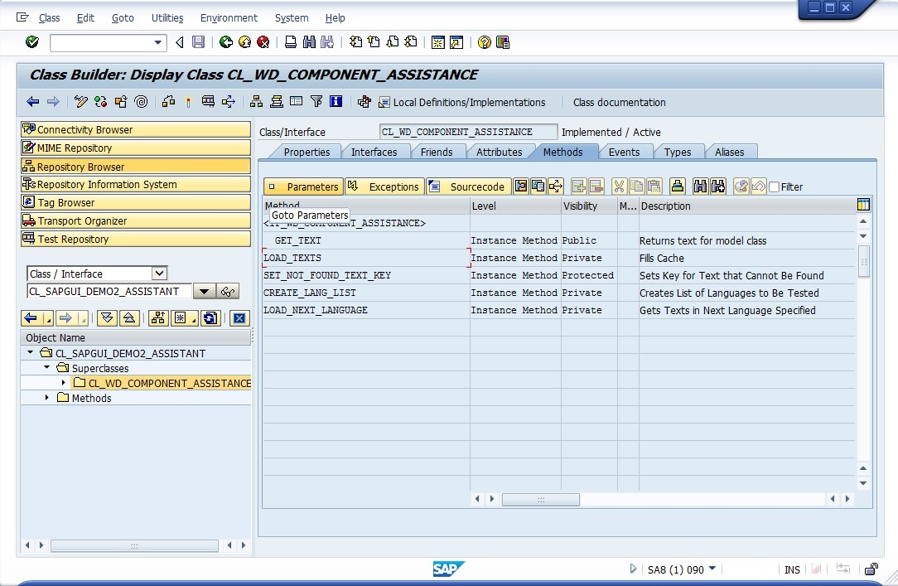
Global Classes in the Object Navigator: Methods
4. Global Classes

Slide 32
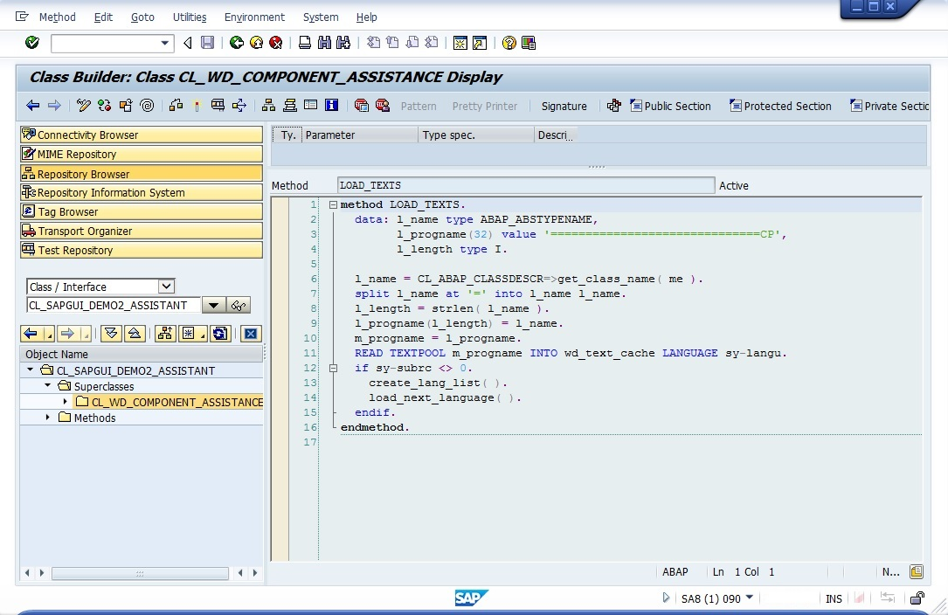
Global Classes in the Object Navigator: Method Implementation
4. Global Classes

Slide 33
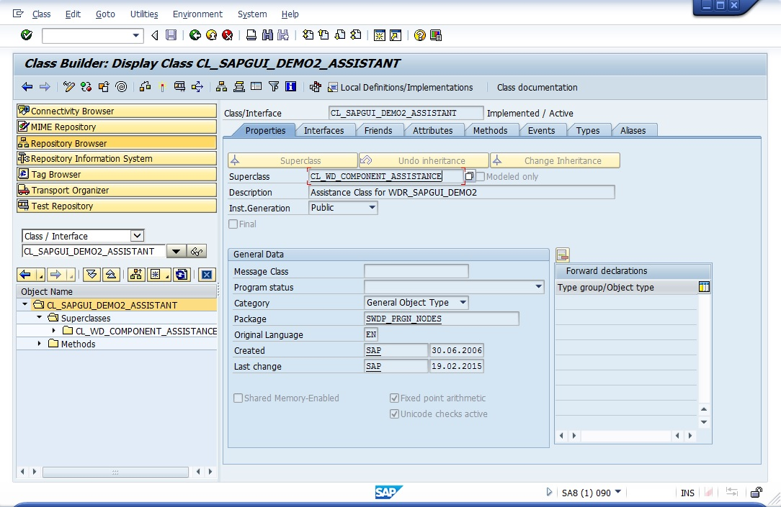
Global Classes in the Object Navigator: Superclasses
4. Global Classes

Slide 34
5. Design Patterns
Singleton
  Singleton design pattern – A simple yet useful example | SAP Blogs
  The singleton design pattern in ABAP Objects - Heiko Evermann's developer notes
Factory
  Factory-Pattern in ABAP OO | SAP Blogs
  ABAP Factory Method Design Pattern (abaptutorial.com)
MVC (Model View Controller)
  Applying MVC in ABAP
  MVC Framework for ABAP

Slide 35


